Slide 1
Unit 1
Introduction

Slide 2
Internet
Internet is the vast network that connects computers all over the world.
People can share information and communicate from anywhere with an internet connection
Is a shot form of technical term internetwork
Also referred as Net
It is based on client server architecture
Is used for purpose like emailing, social networking, chat, information sharing, entertainment, Online jobs

Slide 3
Intranet
Is a local or restricted communication network
Computer network for sharing information and other services within an organization
Primary use it is to help employees securely communicate with each other
Intranet is used to:
Share organizational updates
Store files
Connect employees
Increase productivity
Collaborate with teams

Slide 4
World Wide Web(WWW)
also known as the web, WWW or W3
refers to all the public websites or pages that users can access on their local computers and other devices through the internet
These pages and documents are interconnected by means of hyperlinks that users click on for information
this information can be in different formats, including text, images, audio and video.

Slide 5
Static web pages
Static Web pages are very simple.
It is written in languages such as HTML, JavaScript, CSS, etc
For static web pages when a server receives a request for a web page, then the server sends the response to the client without doing any additional process
Pages will remain the same until someone changes it manually.

Slide 6
Dynamic web pages
Dynamic Web Pages are written in languages such as AJAX, ASP, ASP.NET,Rails etc.
In dynamic web pages, the Content of pages is different for different visitors.
It takes more time to load than the static web page
Dynamic web pages are used where the information is changed frequently, for example, stock prices, weather information, etc.

Slide 7
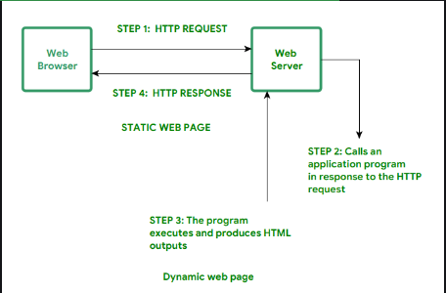

Slide 8
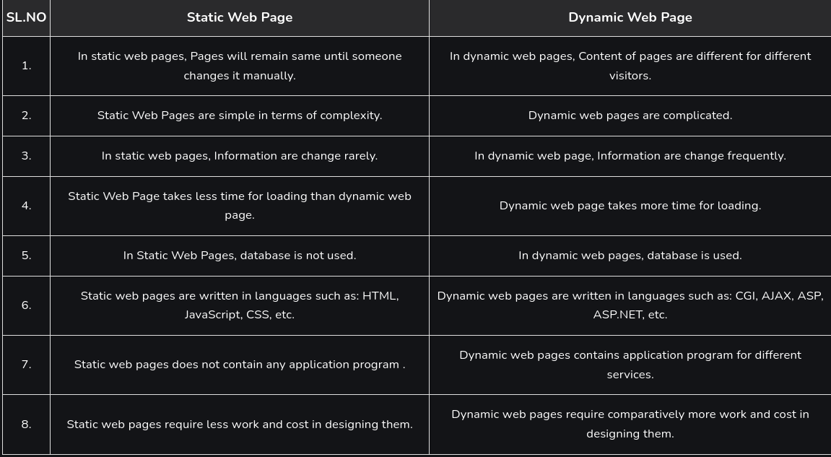

Slide 9
Web Client and Web Server

Slide 10
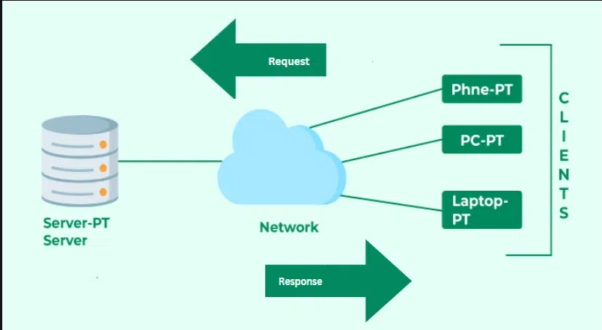

Slide 11
What is Client Server Architecture?
Client-Server Architecture is a network model that allows different applications to exchange data and communicate over a network.
This model divides the system into two parts: a client and a server.
The client is the application that requests services from the server, such as retrieving or storing data, performing calculations, or executing commands.
The server is the application that provides services to the client, such as processing requests, sending responses, or completing actions.
The server and the client communicate using a predefined protocol, such as HTTP, FTP, SMTP, etc.
Client-Server Architecture is widely used for network applications such as email, web, online banking, e-commerce, etc.

Slide 12
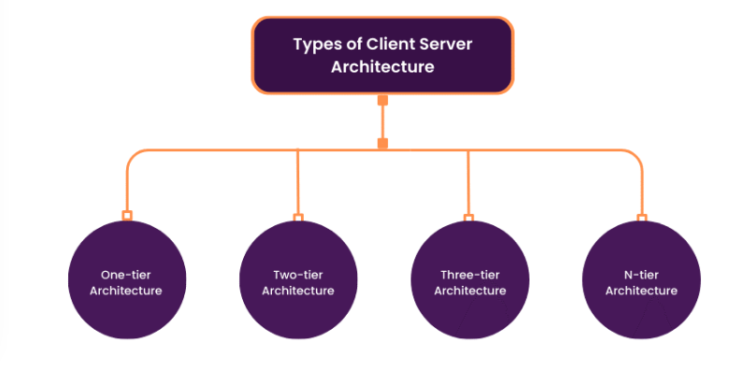

Slide 13
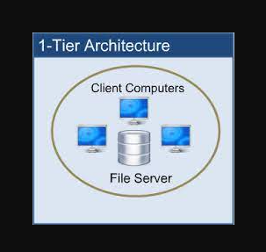
One Tier Architecture
an application is single and self-contained on a single platform.
the client, the server, and the database are all on the same machine
is rarely used in productions as it does not meet the requirements and constraints of most systems.

Slide 14
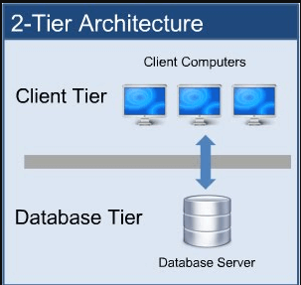
2-Tier Architecture
the client tier handles both Presentation and Application layers and the server handles the Database layer.
is also known as a ‘Client-Server Application’
communication takes place between the Client and the Server
The client system sends the request to the server system and the server system processes the request and sends the response back to the client system.

Slide 15
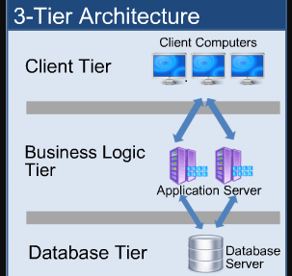
3- Tier Architecture(multi layer architecture)
All three major layers are separated from each other
The presentation layer resides at Client Tier, the Application layer acts as middleware and lies at Business Tier and the Data layer is available at Data Tier. This is a very common architecture.

Slide 16
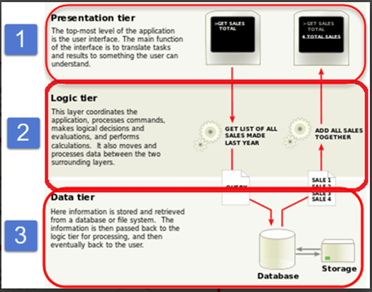

Slide 17
HTTP(Hyper Text Transfer Protocol)
is the foundation of data communication on the World Wide Web
protocol that defines how messages are formatted and transmitted, and how web servers and browsers should respond to various commands
HTTP works as a request-response protocol between a client and a server

Slide 18
HTTP Headers
HTTP headers are key-value pairs that provide additional information about the HTTP request or response
They are included in both the request sent by the client and the response returned by the server.
Headers are essential for conveying metadata, controlling caching behavior, implementing security measures, and facilitating communication between clients and servers
Generally there are 4 types of headers:
General Headers
Request Headers
Response Headers
Entity Headers

Slide 19
General Headers
Cache-control
Connection
Date
Pragma
Trailer
Transfer-Encoding
Upgrade
Request Headers
Accept
Accept Encoding
Authorization
Cookie
Host
User-Agent
Referer
Response Header
Content-Type
Content-Length
Location
Server
Set-cookie
WWW-authenticate
Entity Headers
Content-Encoding
Content-Language
Content-Disposition
Content-range

Slide 20
Status Codes:
HTTP status codes indicate the outcome of a request. Some common status codes include:
1xx: Informational responses (e.g., 100 Continue)
2xx: Success (e.g., 200 OK)
3xx: Redirection (e.g., 301 Moved Permanently)
4xx: Client errors (e.g., 404 Not Found)
5xx: Server errors (e.g., 500 Internal Server Error)

Slide 21
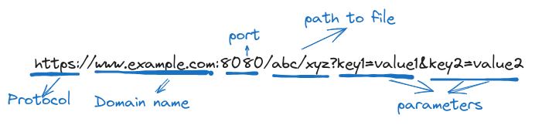
URL
Stands for Uniform Resource Locator
Unique address given to a unique resource on the web
For Example:

Slide 22
Client Side Scripting
Web browsers execute client-side scripting
Source code is used to transfer from webserver to user’s computer over the internet
It is also used for validations and functionality for user events.
Pages are altered on basis of the user’s choice
It can also be used to create “cookies” that store data on the user’s computer
Javascript is one of the client side scripting language

Slide 23
Server side scripting
Web servers are used to execute server-side scripting
They are basically used to create dynamic pages
It can also access the file system residing at the webserver
It is used to retrieve and generate content for dynamic page
It reduces client-side computation overhead.
The server sends pages to the request of the user/client.
Example are pHp,ruby on Rails, python etc

Slide 24
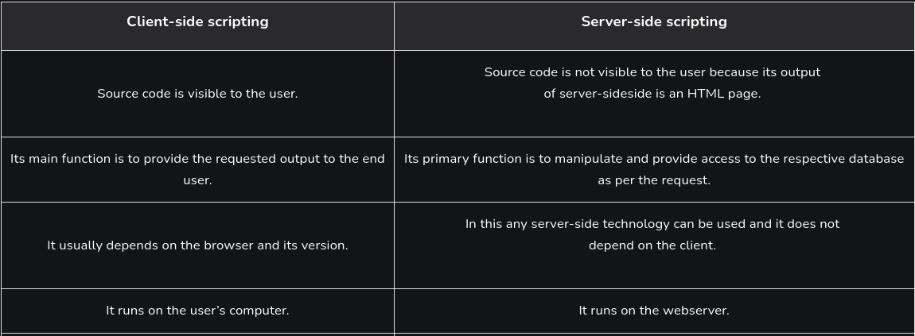
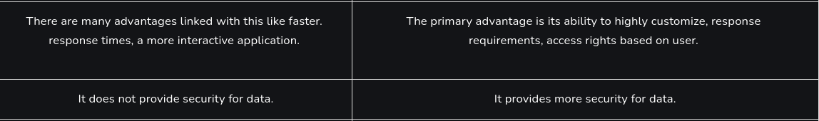

Slide 25
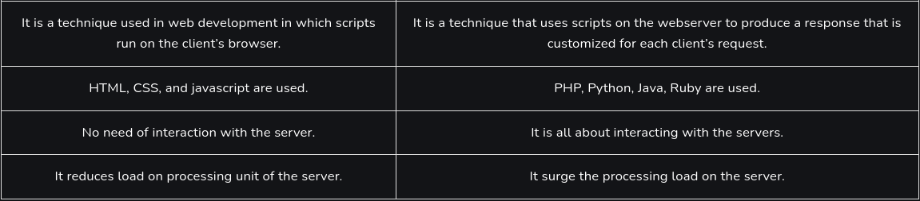

Slide 26
Web 1.0 Web 2.0 and Web3.0
Web 1.0 was all about fetching, and reading information. Web 2.0 is all about reading, writing, creating, and interacting with the end user. It was famously called the participative social web. Web 3.0 is the third generation of the World Wide Web, and is a vision of a decentralized web which is currently a work in progress. It is all about reading, writing, and owning.

